Slide 1
29 years old
Married
Frank Schmidt
Bio
Project leader
Search preferred way of finding information
Karlsruhe
Scientist
Fast finding
Wishes & Needs
Accurate information
City
University
Intuitive usage
Major research university
Contact to experts
Large structured data
Large unstructured data lake

Slide 2
www.intranet.cityuniversity.edu
City University
Intranet
Information
News
MyUniversity
News
REDWOOD SHORES, Calif. – The Cardinal closed out the Stanford Invitational Sunday morning with wins in the first and third varsity eight boats.
Stanford clocked a time of 6:11.9 into the headwind, while the Hoyas finished with a time of 6:28.7.
Stanford faculty, students and staff win grants to advance diversity
Stanford has awarded 20 grants to support innovative initiatives that advance the diversity of the university
School of Engineering
Academics
Events
Students
Faculty & Staff
CityUniversity Today
Campus Life
Law & Policy

Slide 3
www.intranet.cityuniversity.edu
Intranet
City University
Intranet
Information
News
Academics
Events
Students
Faculty & Staff
Campus Life
Machine Learning
Results
Learning.docx
Search Results
Learn with products. Get to know how the world. ..
http://leraningwiththings.edu/download/marz/fff/kkk/learning.docx
40
.docx
Machine.xls
20
.pptx
1+5+4 () . ..
01
.xls
http://leraningwiththings.edu/download/marz/fff/kkk/machine.xls
1.docx
20
.xlsx
http://leraningwiththings.edu/download/marz/fff/kkk/machine.doc
200
.pdf

Slide 4
What can be achieved with COPS?
– using a university as the data source

Slide 6

Extracting Knowledge
f
ff
Cognitive Organizational Platform Service
www.cops.tech

Slide 7

Real-World Problem
Lack of knowledge
Experts inside the company are not connected
Existing solutions cannot be found
…
Online search has become the preferred way of finding information
quickly and accurately
Organizational Structure
Hierarchical
(Formal)
Holacratic
(Informal)
Notes:
it costs to turn the company information overload from a storage problem of the IT department to a valuable asset and business enabler for everybody

Slide 8
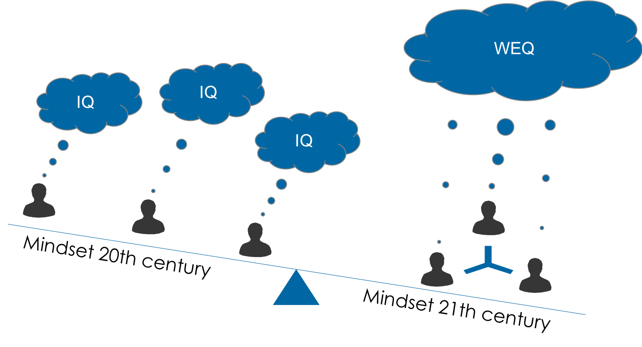
Collaboration before individual knowledge
Notes:
Story:
Xy ist Mitarbeiter in einem ML-Forschungsprojekt und sucht nach einer Lösung um den Serviceprozess innerhalb eines Unternehmens zu verbessert. Da er bisher wenig Erfahrungen hat, sucht er nach einem Paper und einer Anprechperson, die dazu

Slide 9
Integration
User
Search-
engine
Intranet

Slide 10


Technological implementation
Summary
Image
processing
NLP
Tags
Entities
Classifi-
cation
Type

Slide 11
Use Cases
Which departments are working on …?
Who is an expert in ...?
People
Departments
Does the solution exists already in …?
Business Units
Information
Is the error documented?
Was there already a similar project?
I don’t have information about …?
State of research?
Wiki
Document
Systems
External

Slide 12
Summary
Monitor
Enable people to work faster
Enable people to produce better quality
Inspire your employees to innovate and invent
Effect on workflows
Communication between people
user behavior through search logs
the average ranking of a clicked hit in the result list
the amount of users that are using the system
estimate the level of information your users are expecting
Cognitive search engine is a leverage for efficiency

Slide 13



Who are we?
Sebastian Findeisen
-
Informationswirtschaft
4. Mastersemester
Manuel Lang
-
Informatik
4. Mastersemester
Jan Kielmann
-
Informatik
1. Mastersemester
Fabian Retkowski
-
Informatik
2. Mastersemester

Slide 14
Thank you!

Slide 15
www.intranet.cityuniversity.edu
Intranet
City University
Intranet
Information
News
Academics
Events
Students
Faculty & Staff
Campus Life
Feature Engineering
Results
FeatureEngineering-ProcessSupport.docx
Contact
A common grievance of customers navigating any support process is the length of time it takes to resolve an issue. .... the company to think about the support issues riders and drivers might face while using their features by making support implications a critical section in feature engineering documents.
Chat
Date: 18.05.2017 Paper: High Class Research Rating: 10 Author: Alecandre Alahi
016328711917
http://leraningwiththings.edu/download/marz/fff/kkk/ FeatureEngineering-ProcessSupport.docx
Alexandre Alahi
Feature Engineering
ML expert
CV
Related Project Paper
FeatureEngineering-Process.pdf
Chat
Feature engineering is the process of using domain knowledge of the data to create features that make machine learning algorithms work. Feature engineering is fundamental to the application of machine learning, and is both difficult and expensive. The need for manual feature engineering can be obviated by automated ...
016328711957
Matei Zaharia
Feature Engineering
Algorithm expert
Date: 18.11.2019 Paper: High Class Research Rating: 10 Author: Alecandre Alahi
CV
Related Project Paper

Slide 16
Story
Search Engine
Extracting Knowledge
time
Problem
Problem
Searching
Project-
description
Searching
Contact to
experts
Solve
problem
Online
Research
External
Consulting
Solve
Problem

Slide 17
Further features (knowledge vector)
Connecting people with lack of knowledge with
Domain experts
Relevant Publications
Several structured/unstructured sources
Extracted Knowledge out of other systems

Slide 18
Zurück

Slide 19
Alexandre Alahi
alahi@umich.edu
Zurück

Slide 20
Zurück

Slide 21
Matei Zaharia
m.zaharia@usv.edu
Zurück

Slide 22
Quellen - Bilder
Mann auf der Leiter
https://www.firestock.ru/muzhchina-s-binoklem-na-lestnitse-man-with-binoculars-on-the-stairs/
Frau mit Glühbirne
https://www.christiancourier.com/articles/771-my-people-are-destroyed-for-a-lack-of-knowledge
Straßenpfeiler
http://cordantsolutions.com/opioid-overdose-statistics-vary/
Kopf
https://www.businesswire.com/news/home/20150220005498/en/Report-Cognitive-Scale-Recognized-Independent-Research-Firm
Mann mit Fernglas
https://www.groupecho.com/en/corporate-validation.htm

